Slide 1

Recipe Recommender Assignment
By
Vrushali Rane
Viraj Morgaonkar

Slide 2




Problem Statement:
Design and implement a recipe recommendation engine to enhance user engagement and increase revenue opportunities by providing users with personalized recipe recommendations based on their preferences and the current recipe they are viewing.
Objective:
Develop a recommendation system that can suggest relevant recipes to users, considering their current viewing preferences and behaviors.
Scope:
The recommender system will be implemented by using a variety of data sources, including user ratings, and recipe features, to generate recommendations.
Benefits:
Users are more likely to spend more time on website if they are shown relevant recipes that they are interested in. Higher user engagement is likely to result in more business opportunities, such as collaborations and promotions. Users are more likely to be satisfied with the website if they are able to find the recipes that they are looking for easily.

Slide 3
Approach
This case study will focus on building a machine learning model to predict the rating of a recipe based on its features.
The features will be extracted from the two data files: RAW_recipes.csv and RAW_interaction.csv.
The approach will be as follows:
Data preparation:
Read the two data files and join them on the recipe ID.
Clean the data and ensure that each field has the correct data type.
Extract the individual features from the various columns.
Standardize the nutrition column and convert the nutritional values to per 100 calories.
Convert the tags column from a string to an array of strings.
Feature engineering:
Create time-based features to capture the time passed between one review and the date on which the recipe was submitted.
Convert all numerical columns to categorical columns using the percentile approach.
Create user-level features to capture the essential preferences of each user.
Create tag-level features to capture the information contained in the tags.

Slide 4
Methods
Methods:
The following method are used to implement the approach described :
Used PySpark to read the data files from AWS S3 bucket, extract individual features from the nutrition column, standardize the nutrition values, convert the tags column from a string to an array of strings, create the time-based features
Used Pandas, NumPy, Matplotlib for bucketing and cleaning numerical features as well as to add user-level, tag-level featured and performed EDA on it.
The specific machine learning algorithm that will be used will be determined based on the results of a preliminary analysis of the data.
Optional tasks:
The following tasks are optional:
Convert the numerical columns to categorical columns allowing a model the opportunity to build a nonlinear relationship..
Created user-level features to capture the essential preferences of each user.
Created tag-level features to capture the information contained in the tags.

Slide 5
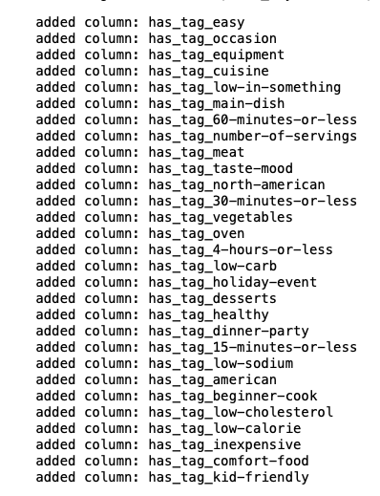
Top 5 percentile of frequent tags:
These tags suggest that users are interested in a variety of recipes, but that they are particularly interested in recipes that are easy to make,
quick to make, and healthy. Users are also interested in recipes that are appropriate for specific occasions and that contain specific ingredients or cuisines.

Slide 6
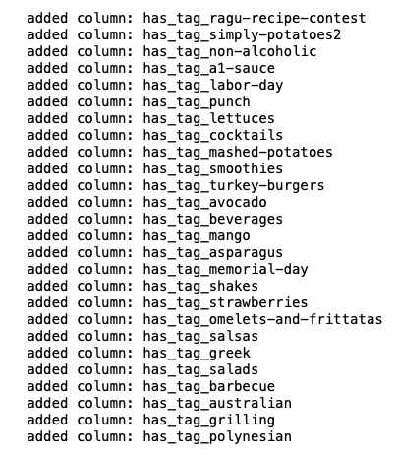
Top 5 percentile of highest-rated tags:
These tags suggest that users are interested in a variety of recipes, but that they are particularly interested in recipes for meat, vegetables, drinks,
desserts, and breakfast. Users are also interested in recipes that are appropriate for specific occasions and that are made with specific ingredients or cuisines.

Slide 7
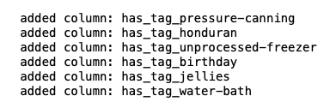
Bottom 5 percentile of highest-rated tags:
These tags suggest that users are interested in a variety of recipes, but that they are particularly interested in recipes for canning, freezing, and desserts.
Users are also interested in recipes that are appropriate for specific occasions, such as birthdays.
However, since these are the bottom highest-rated tags, we may should be careful about recommending them to users.
It is possible that users are only watching these recipes because they are curious about the topic or because they are looking for a specific
recipe that is difficult to find.

Slide 8
Conclusion
Users have a diverse range of interests when it comes to recipes, including easy and quick-to-make recipes, healthy options, and recipes suitable for specific occasions.
There is a significant interest in recipes featuring meat, vegetables, drinks, desserts, and breakfast dishes.
Some users have a particular interest in recipes related to canning, freezing, and desserts. Recipes appropriate for specific occasions, such as birthdays, also attract user attention.
The tags mentioned as "bottom highest-rated" may not be as popular among users. Users watching recipes in these categories might be driven by curiosity or a specific search rather than a broad interest.
Based on these conclusions, when recommending recipes to users, it is essential to prioritize popular and highly-rated tags such
as easy-to-make, quick, healthy, meat, vegetables, drinks, desserts, and breakfast. These tags seem to align with users' preferences and interests.
However, it's also important to consider user-specific preferences and provide a variety of options to cater to different tastes and needs.

